Slide 1
Unit 4
Part B
Economics in Cloud
Abhishek Bhattacherjee

Slide 2
Contents
Cloud Economics :
Developing an Economic Strategy
Exploring the Costs
Laws of cloudonomics
Cost estimation

Slide 3
Cloud economics!
Cloud economics is the study of cloud computing costs and benefits and the economic principles that underpin/support them.

Slide 4
Developing an Economic Strategy
Reducing operating costs and optimizing IT environments are pivotal/crucial to understanding and being able to compare the cost models behind provisioning on-premise and cloud-based environments.
The pricing structures used by public clouds are typically based on utility-centric pay-per-usage models, enabling organizations to avoid up-front infrastructure investments.
These models need to be assessed against the financial implications of on-premise infrastructure investments and associated total cost-of-ownership commitments

Slide 5
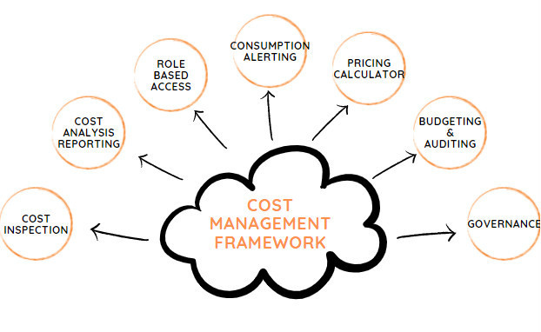

Slide 6
In detail…
1. Visibility on Cloud Inventory
According to a recent survey of IT professionals, 75% report, they lack visibility of their cloud resources. This lack of visibility into resources in the cloud can lead to poor management of those resources.
Effective cloud cost management begins with an in-depth analysis of your entire infrastructure. And if some resources in the cloud are going unused due to lack of awareness, but the organization is still paying for them, cloud costs will climb unnecessarily – and cut into the infrastructure savings and other financial benefits the cloud can bring.
Admins who have access to a single pane of glass and detailed Resource Dashboards are equipped to better organize, manage, and optimize that ecosystem across all accounts, clouds, departments, and teams.

Slide 7
In detail…
2. Cost Analytics :
Complete visibility on the cloud services used, the actual usage patterns and trends is the first step. No matter your cloud environment, in addition to tracking what you have spent, it is important to project what you will be spending. You need consolidated as well granular details in the form of interactive graphical and tabular reports across multiple dimensions, time frames in a multi-cloud environment to correlate data for analysis and reporting against business objectives.
3.Role Based Access :
Permit users to actively manage the infrastructure after setting an Enterprise-wide mechanism that clearly defines permissions and accessibility within the platform. Limit the data and actions visible to users by organizations and roles and identify who launched, terminated, or changed infrastructure, and what they did to take corrective action and control costs.

Slide 8
In detail…
4. Controlled Stack Templates :
A crucial characteristic of any DevOps team is to enable teams more autonomy over-provisioning resources without the red tape and extensive time delay of traditional IT environments. If it is implemented without the accompanying automation and process best practices, decentralized teams have the potential to produce convoluted and non-standard security rules, configurations, storage volumes, etc. and therefore drive up costs.
Using predefined stack templates, Administrators can bake in security, network, and instance family/size configurations, so that the process of deploying instances is not only faster but aligned with the Departmental user’s roles and privileges and ensures only specific Resources are provisioned.

Slide 9
In detail…
5. Automated Alerts and Notifications :
Stay on top of day-to-day changes in your environment, and participate in the critical decision by sharing standard and custom built reports with details on cost, usage, performance with stakeholders. Automated alerts and notifications about authorization failures, budget overruns, cost spikes, untagged infrastructure result in increased visibility and accountability.
6. Budgets :
Define and allocate budgets for Departments, cost centers, projects and ensure approval mechanisms to avoid cloud cost overrun by sending out alerts when thresholds are breached. Use the Showback report to chargeback Departments for their cloud usage and limit the cloud cost and use of resources. This alignment of cost with value ensures the anticipated business benefit once the cloud resources are in production

Slide 10
In detail…
7. Policy Based Governance :
Use cloud-based governance tools to track cloud usage and costs and alert administrators when the total usage for the account is greater than a certain value or when the total usage for a vendor specific product is greater than a certain value helps control cost.
Schedule operational hours to automatically shut down & start virtual machines, and automated events that alert administrators on volumes that have been disassociated from Virtual machines (standalone VMs) for more than a set number of days.
In short, use integrated data sources, metadata, or custom tags to define a set of rules that lead to improved cost management, reporting and optimization.

Slide 11
Exploring
The costs
• Up-front costs for the purchase and deployment of on-premise IT resources tend to be high. Examples of up-front costs
for on-premise environments can include hardware, software, and the labor required for deployment.
• Up-front costs for the leasing of cloud-based IT resources tend to be low. Examples of up-front costs for cloud-based
environments can include the labor costs required to assess and set up a cloud environment.
Up-Front Costs
Up-front costs are associated with the initial investments that organizations need to make in order to fund the IT resources they intend to use. This includes both the costs associated with obtaining the IT resources, as well as expenses required to deploy and administer them.

Slide 12
On-going Costs
• On-going costs for the operation of cloud-based IT resources can also vary, but often exceed the on-going costs of on-premise
IT resources (especially over a longer period of time). Examples include virtual hardware leasing fees, bandwidth
usage fees, licensing fees, and labor.
On-going costs represent the expenses required by an organization to run and maintain IT resources it uses.
• On-going costs for the operation of on-premise IT resources can vary. Examples include licensing fees, electricity, insurance, and labor.

Slide 13
10 Law’s of Cloudonomics

Slide 14

1.Utility services cost less even though they cost more.
Notes:
Individual business cost more as compared with cloud sp

Slide 15
Eg: Pay-for-Use if you start an organization with 100k machines then you may invest crore’s of rupees, but if you go for cloud utility then probably you can join there while paying only in lac’s .

Slide 16
Although utilities cost more when they are used, they cost nothing when they are not. Consequently, customers save money by replacing fixed infrastructure with Clouds when workloads are spiky, specifically when the peak-to-average ratio is greater than the utility premium.

Slide 17
2. On-demand trumps forecasting.

Slide 18
Eg: Don’t buy the infrastructure before you start. Win-trump

Slide 19
Forecasting is often wrong, the ability to up and down scale to meet unpredictable demand spikes allows for revenue and cost optimalities.

Slide 20
3.The peak of the sum is never greater than the sum of the peaks.

Slide 21
Eg: Big-billion value sale(peak of the sum) < sum of the peaks on other days of sale

Slide 22
Enterprises deploy capacity to handle their peak demands. Under this strategy, the total capacity deployed is the sum of these individual peaks. However, since clouds can reallocate resources across many enterprises with different peak periods, a cloud needs to deploy less capacity.

Slide 23
4. Aggregate demand is smoother than individual.

Slide 24
Eg“: a) 100 people demand 1 service from cloud b) 1 person demand 1 service from cloud provider will chose (a) – option because investment in 1 service will pay more in (a) and cover maintenance charges.

Slide 25
Aggregating demand from multiple customers tends to smooth out variation. Therefore, Clouds get higher utilization, enabling better economics.

Slide 26
5. Average unit costs are reduced by distributing fixed cost over more units of output.

Slide 27
Eg: If: a) 100 Rs required to produce 10 items b) 100 Rs required to produce 25 items we will choose (b) always as unit cost is less in (b)

Slide 28
They are reduced by distributing fixed costs over more units of output. Larger cloud providers can therefore achieve economies of scale.

Slide 29
6. Superiority in numbers is the most important factor in the result of a combat.

Slide 30
Eg: a) if cloud-A shows 1000 available servers with 1gbps speed b) if cloud-B shows only 10 servers with 10kbps of speed. than we will go for(a) only

Slide 31
Superiority in numbers is the most important factor in the result of a combat. Service providers have the scale to fight rogue attacks.

Slide 32
7. Space-time is a continuum.

Slide 33
Eg: Must be up-to date as per time. Never degrade ever.

Slide 34
Organizations derive competitive advantage from responding to changing business conditions faster than the competition.
With cloud scalability, for the same cost, a business can accelerate its information processing and decision-making.

Slide 35
8. Dispersion is the inverse square of latency.

Slide 36
Eg: If a company has all datacenters at one region then that region has good connectivity and very low latency, but other region will get no service or very high latency. High wide than less latency Less wide than High latency

Slide 37
Reduced latency is increasingly essential to modern applications. A Cloud Computing provider is able to provide more nodes, and hence reduced latency, than an enterprise would want to deploy.
D=1/l2

Slide 38
9. Don’t put all your eggs in one basket.

Slide 39
Eg: Don’t put all datacenters in one region.

Slide 40
A data center is a very large object. Private data centers tend to remain in locations for reasons such as being where the company was founded, or where they got a good deal on property or a lease.
A Cloud service provider can locate greenfield sites optimally and without such limits of legacy logic.

Slide 41
10. An object at rest tends to stay at rest.

Slide 42
Eg: Datacenters can not be moved from the existing location.

Slide 43
A data center is a very, very large object. While theoretically, any company can site data centers in globally optimal locations that are located on a core network backbone with cheap access to power, cooling and acreage.
Instead, they remain in locations for reasons such as where the company or an acquired unit was founded, or where they got a good deal on distressed but conditioned space.

Slide 44
Cloud Cost
Estimator
It helps to determine how much will it cost you, if you happen to purchase…

Slide 45
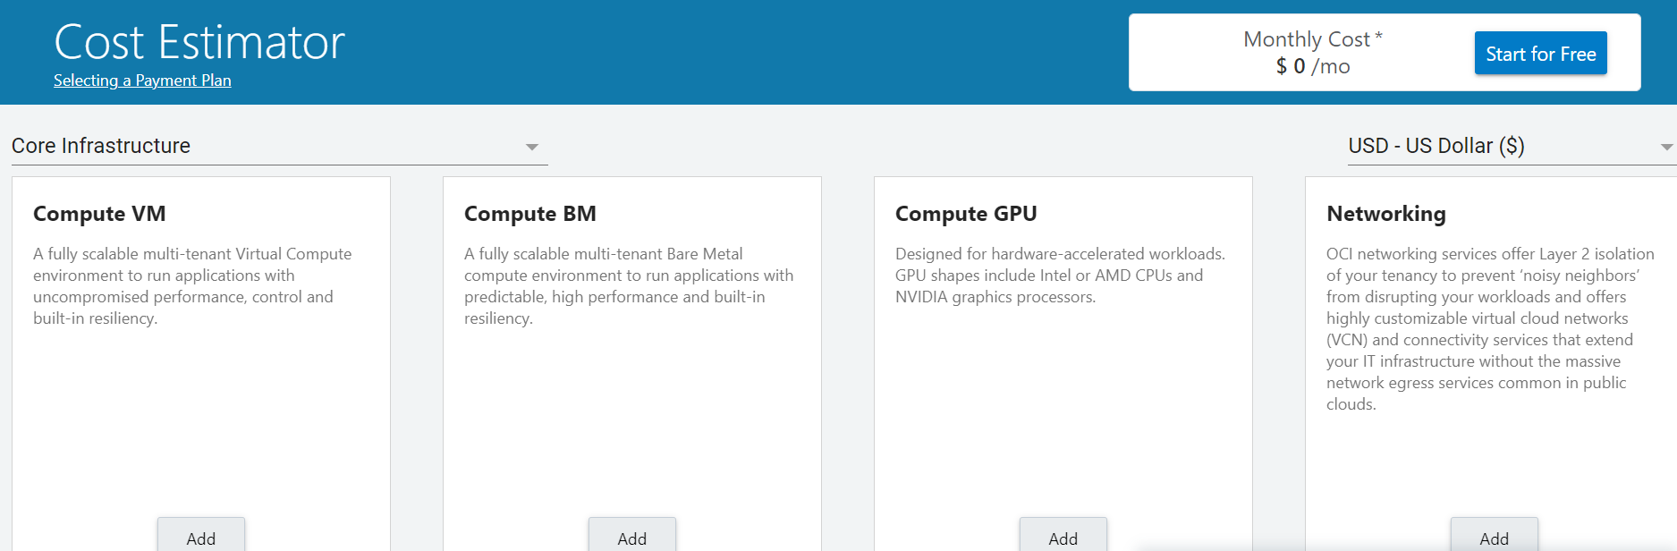
An example Oracle cloud Cost Estimation Tool…

Slide 46
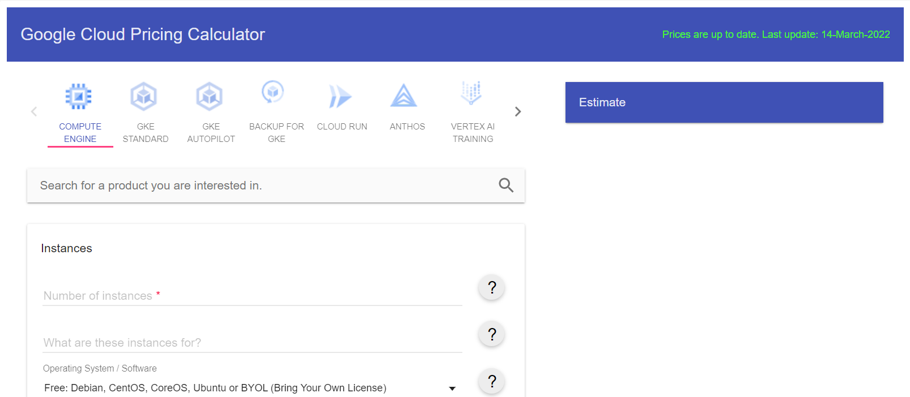
There’s one for google too…

Slide 47
Economics of Cloud Computing
Economics of Cloud Computing is based on the PAY AS YOU GO method. Users/Customers must have to pay only for their way of the usage of the cloud services.
It is definitely beneficial for the users. So the Cloud is economically very convenient for all. Another side is to eliminate some indirect costs which is generated by assets such as license of the software and their support.
Economical background of the cloud is more useful for developers in the following ways:
- Pay as you go model offered by cloud providers.
- Scalable and Simple.

Slide 48
Cloud Computing Allows:
Reduces the capital costs of infrastructure.
Removes the maintenance cost.
Removes the administrative cost.
There are three different Pricing Strategies that are introduced by Cloud Computing:
Tiered Pricing,
Per-unit Pricing, and
Subscription-based Pricing.

Slide 49
Tiered Pricing: Cloud Services are offered in the various tiers. Each tier offers to fix service agreements at a specific cost. Amazon EC2 uses this kind of pricing.
Per-unit Pricing: The model is based upon the unit-specific service concept. Data transfer and memory allocation include in this model for specific units. GoGrid uses this kind of pricing in terms of RAM/hour.
Subscription-based Pricing: In this model, users are paying periodic subscription fees for the usage of the software.

